Slide 1






Destination Database
By
Zehra Punjwani

Slide 2
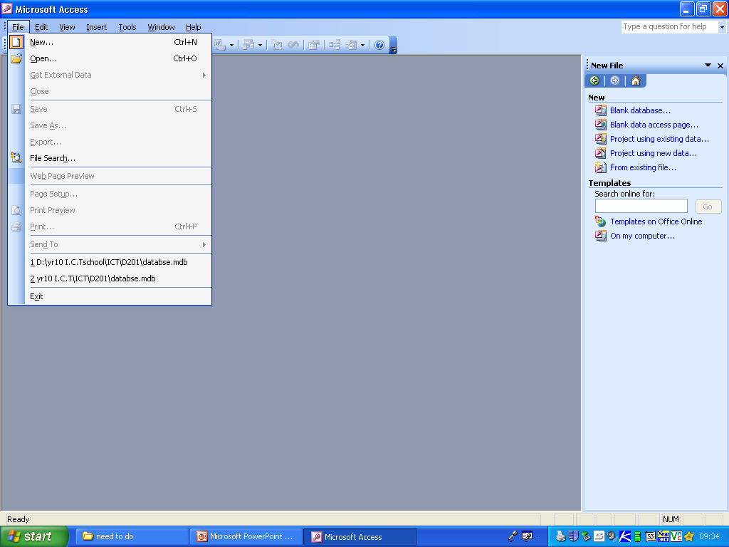
New Database
1.Click on File New Database
2.Then Save It (CTRL S)
Or go to file - save
3.Blank Database

Slide 3
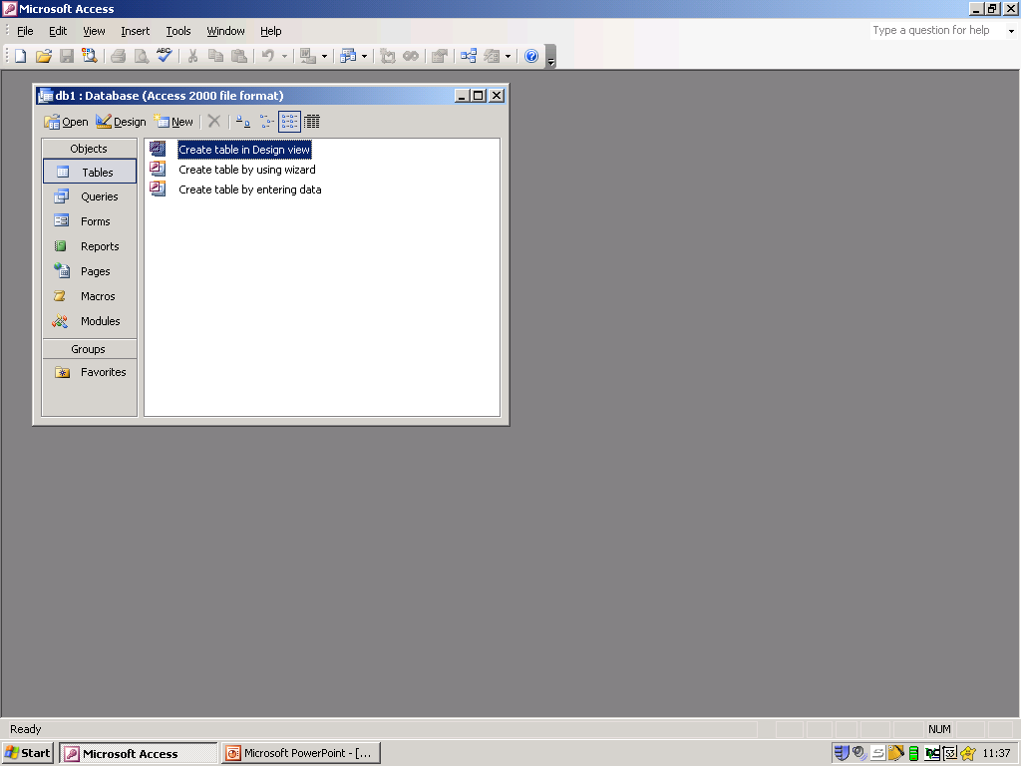
Switch Board
*In this database make sure that you only use the following options:
1.Tables
3.Forms
2.Queries

Slide 4
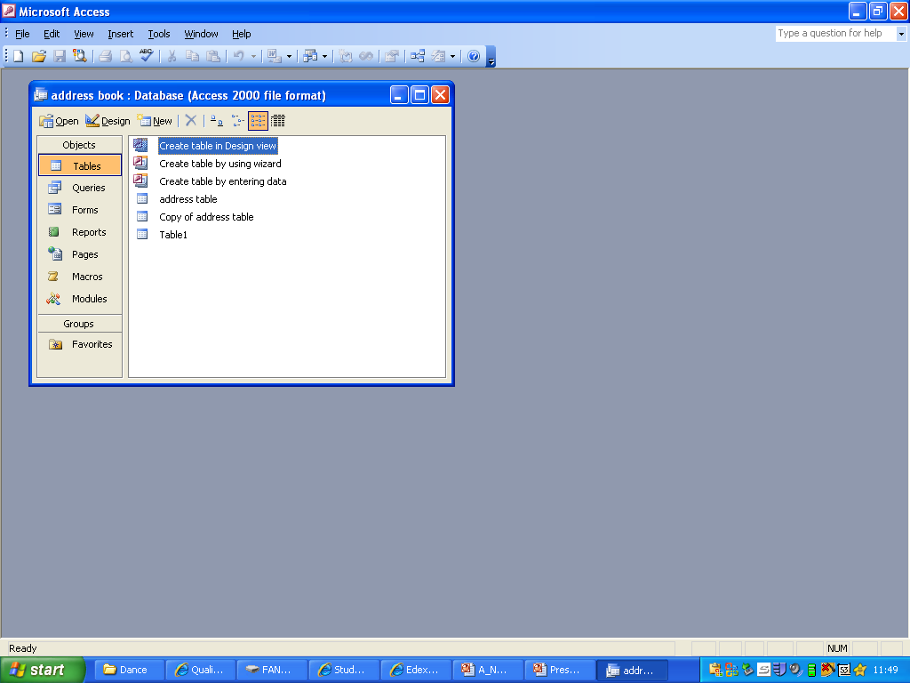
Making a Table
To make a new table in design view, make sure you are following the step one by one and not jumping to another
1.Create table in design
view
1.Open it and place all the data in

Slide 5
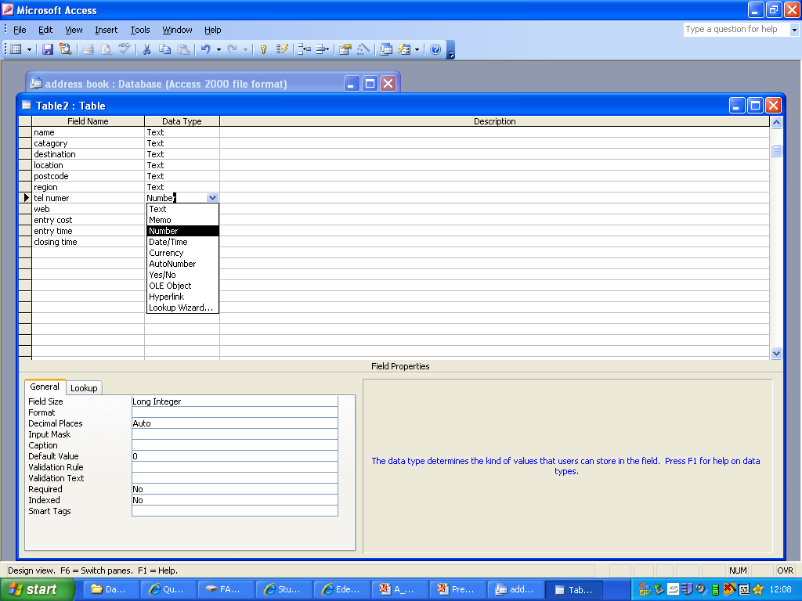
Making a Table
If you want a new text then click on the link beside ‘TEXT’
Click a text that suits best for the option in the column ‘FIRST NAME’
*Make sure that the text you select refers back to the name you have inserted in the column ‘FIRST NAME’

Slide 6
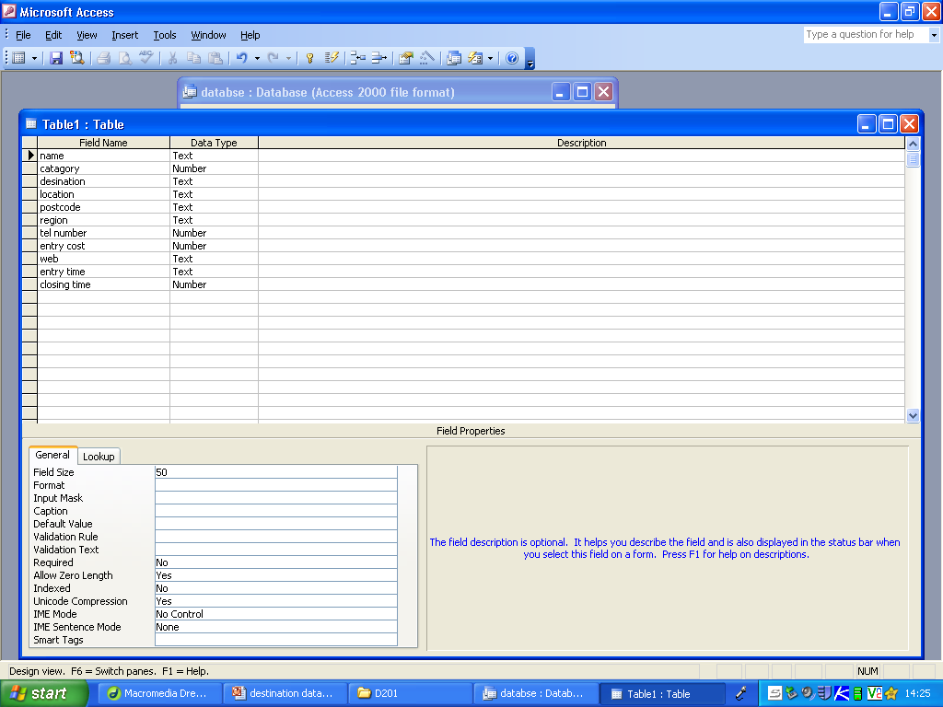
Validation Rule
Create A Validation Rule-
Click on the Field Box
Go onto Validation Rule
Then Three Dots will appear.
The Expression builder will also appear, Minimise mistakes , then Click OK once your Finished

Slide 7
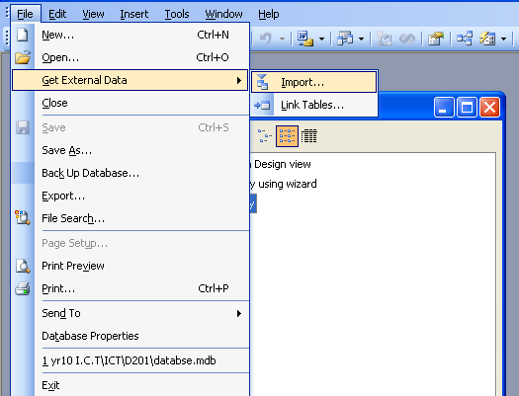
Important Data
This is how I import new data for my database from the Dida website
First of all “GO TO FILE”
Then click on ‘GET INTERNAL DATA’
And lastly click on ‘IMPORT’ to important data for the database from the Dida website

Slide 8
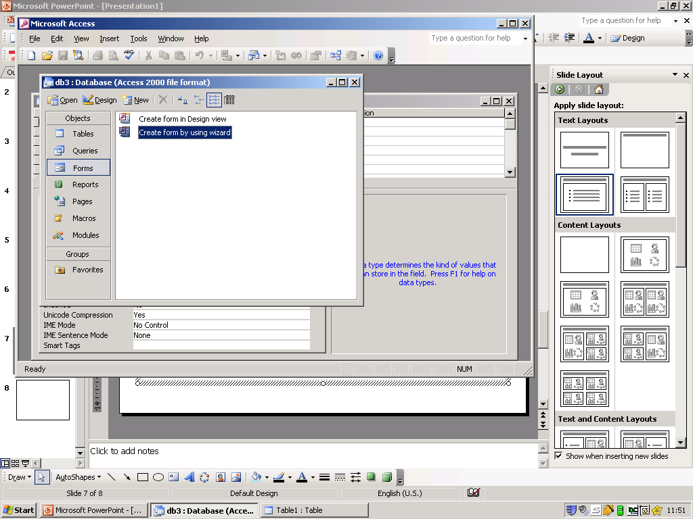
Making a form
This is how I create a form on Microsoft access
*WHILE DOING THIS MAKE SURE THAT YOU HAVE SELECTED THE RIGHT OBJECT AND NOT ANY OTHER OBJECTS
1.Create a Form then Go back to making a table
2. Go on to forms click
on Wizard

Slide 9
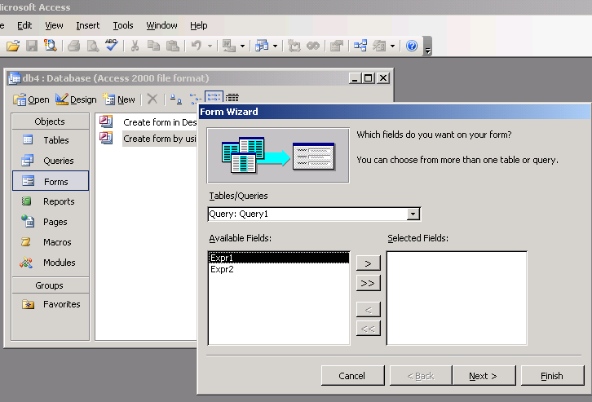
Making a form
3. Make Sure it say’s
table not Query
4.Click on it twice
5.give it an appropriate name
6. A form should then appear
7.Input a new record
*when you finish press “NEXT”

Slide 10
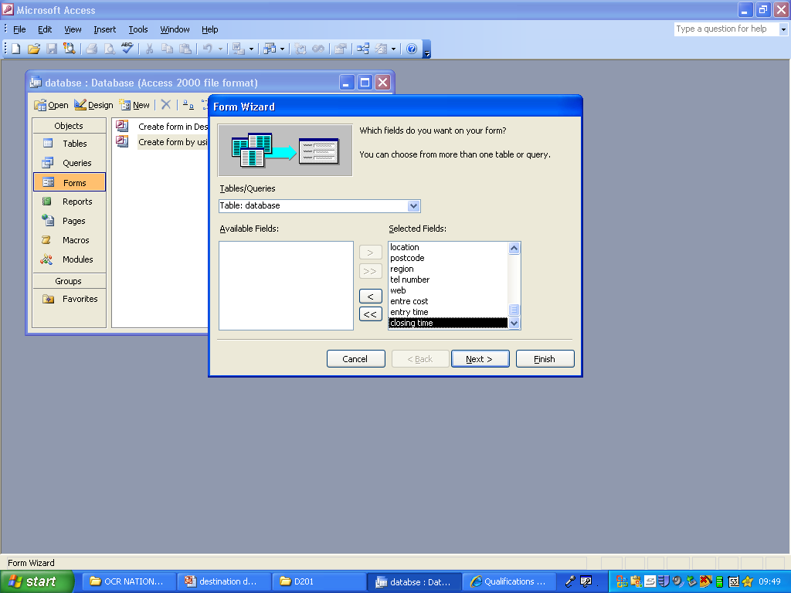
Database
This is how I create a database in form
Select on form
And a table should appear in front of you
Then move all the data from AVALIBALE FIELD to SELECTED FIELD by clicking on the arrow that looks like
Later on click “NEXT” and you should have a table appear in front of you

Slide 11
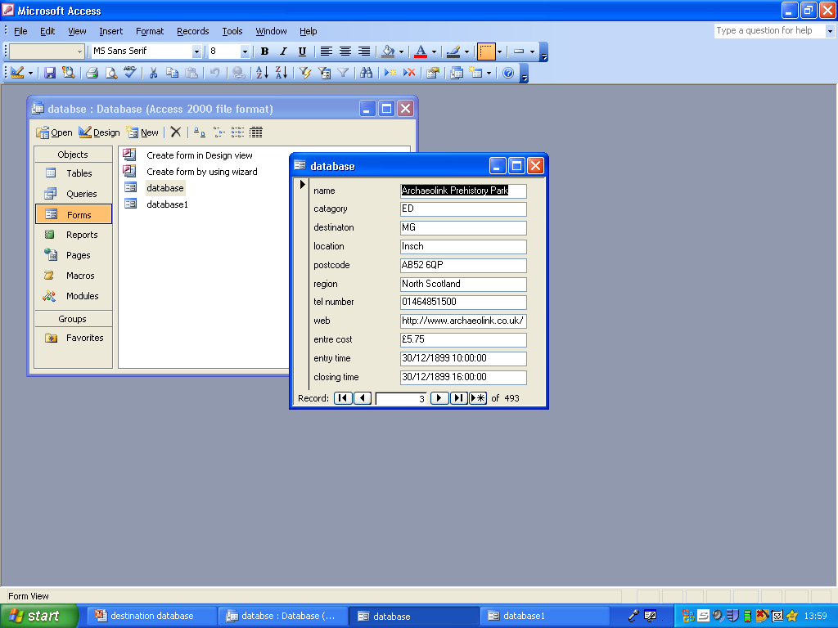
Database
After you see a table appear in front of you
Add in all the data by clicking on the next or previews arrow
At that time save this database when you finish

Slide 12
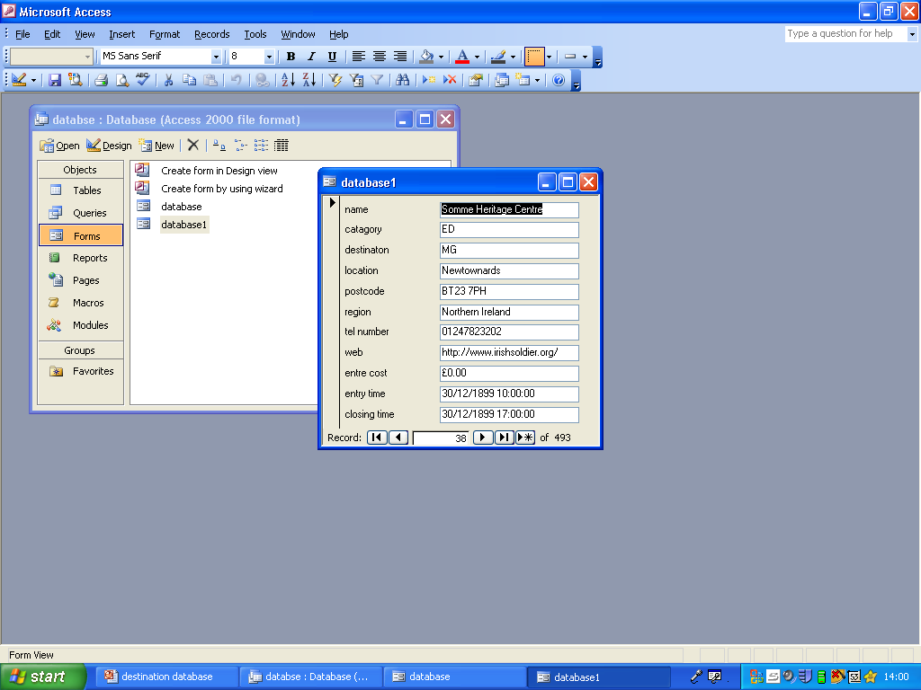
Database
*DO THE SAME WITH MAKING ANOTHER TABLE AND THEN SAVE IT

Slide 13
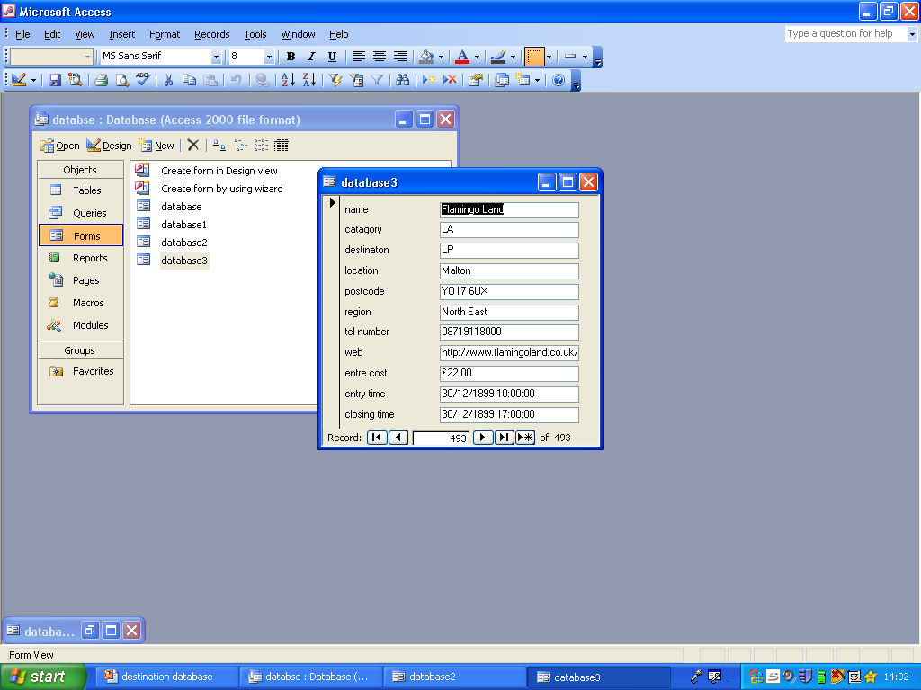
Database
*DO THE SAME WITH MAKING ANOTHER TABLE AND THEN SAVE IT

Slide 14
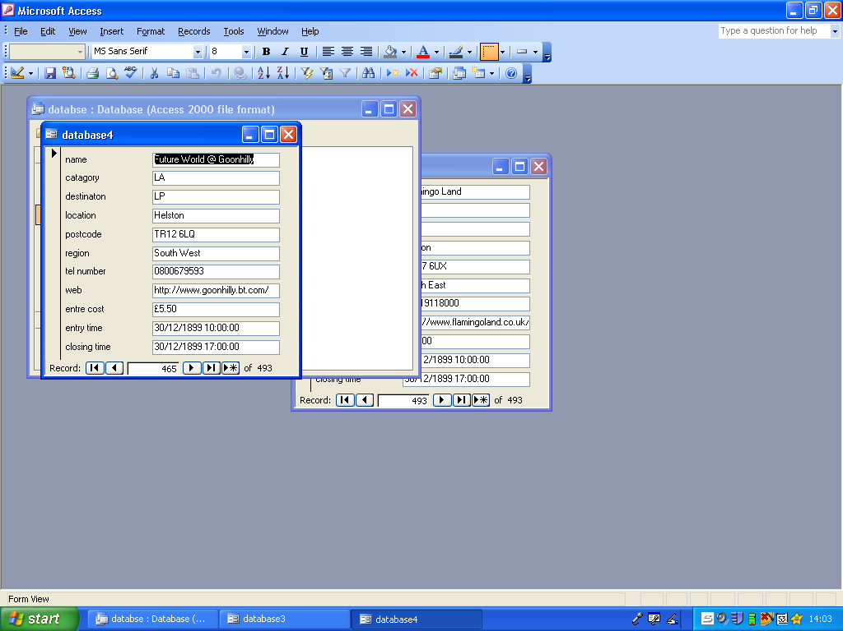
Database
*DO THE SAME WITH MAKING ANOTHER TABLE AND THEN SAVE IT

Slide 15
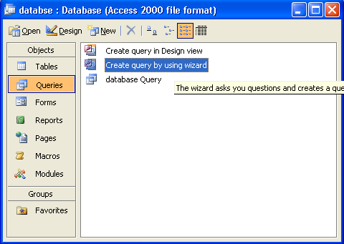
Query
Select query and not table or form
click on ‘CREATE QUERY BY USING WIZARD’
And insert your data
*MAKE SURE THAT YOU ARE SAVING ALL YOUR WORK THAT YOU ARE DOING

Slide 16


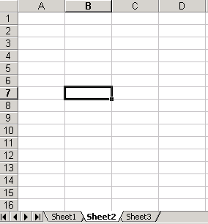
The End

